Slide 1


Teignbridge Cycle Forum
17:00 – 17:10 Welcome, & 20mph trial update Cllr Jackie Hook, TDC & DCC
17:10 – 17:15 Recovery survey Lizzie Turner, TDC Recycling Officer
17:15 – 17:25 Multi-user Route Maintenance Ros Mills,DCC PROW Manager
17:25 – 17:55 Teign Estuary Trail update Roger North, DCC Senior Engineer
17:55 – 18:25 Update on other cycle schemes Estelle Skinner, TDC GI Officer
18.25 – 18.35 Update on Dartmoor active travel Jen Manning, DNPA Recreation Officer
18.35 – 18.45 Protected Sites & Cycling David Rickwood, Woodland Trust
18:45 – 19:00 Any other business, events, notifications etc (further follow up questions / input)

Slide 2

Welcome & Overview
Councillor Jackie Hook,
Devon County Council Councillor
Teignbridge District Councillor, Climate Emergency Portfolio Holder
Local Ward, Newton Abbot North
Please be patient with us, for a smooth virtually-hosted meeting.
Raise your ‘virtual’ Zoom hand to indicate you want to ask a question
At end of each presentation we will invite a few questions by calling your name (as displayed on Zoom)
Once you have spoken please put your raised Zoom hand down

Slide 3
Recovery Survey - Teignbridge
Lizzie Turner, elizabeth.turner@teignbridge.gov.uk
Recycling Officer, Teignbridge District Council
Focus: Environment & Place
Public input needed to shape this!
Link is below & will be included in Cycle Forum minutes
www.surveymonkey.co.uk/r/PlaceC19

Slide 4
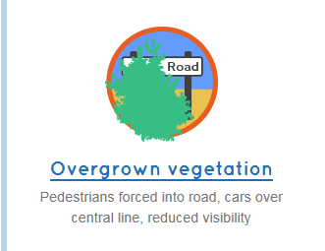
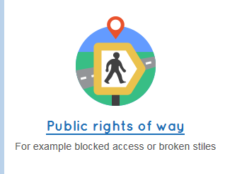
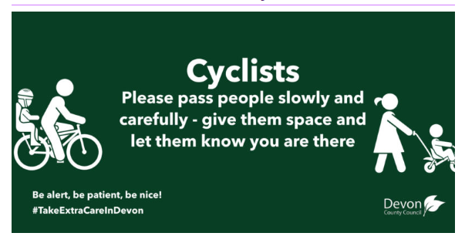

Cycling / Multi-user Route Maintenance
Ros Mills, Public Right of Way (PROW) &
County Parks Manager
Devon County Council
Cycle Forum minutes will include a link to
share this space information

Slide 5
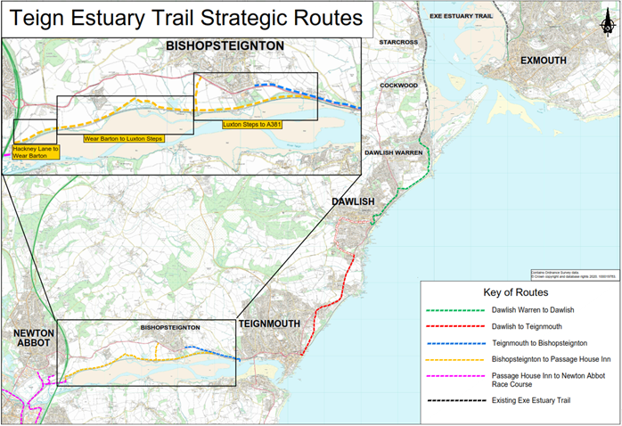
Teign Estuary Trail Update, Roger North DCC

Slide 6
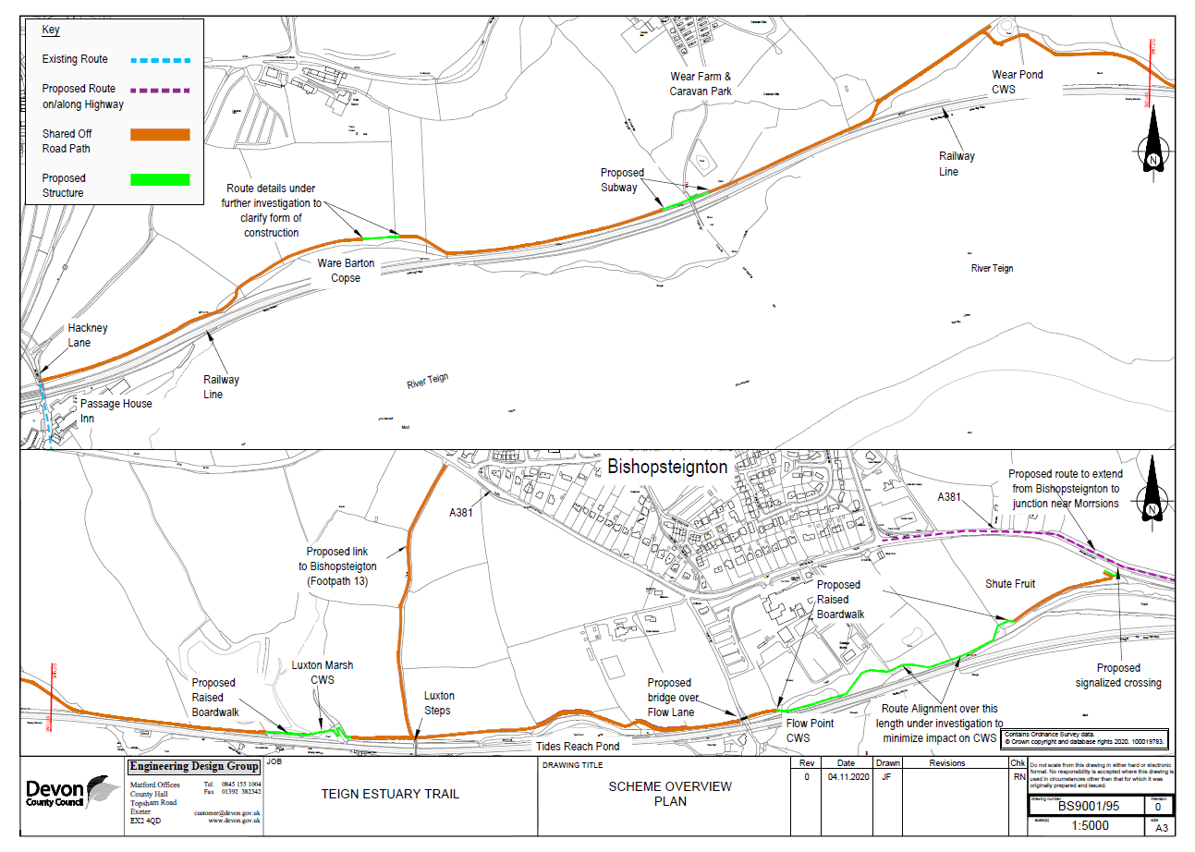

Slide 7
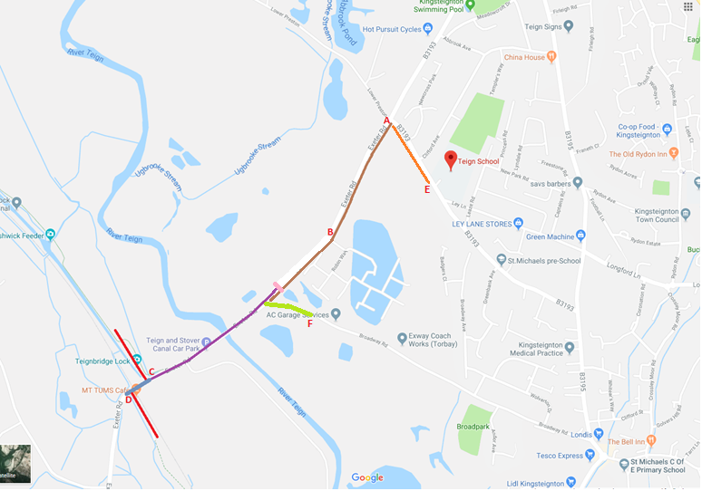
Kingsteignton, Stover Way link

Slide 8
Baker’s Park / Ogwell Route
Linkage from existing NCN Route 2 (ASDA / River Lemon) via Baker’s Park & Bradley, old nursery to Beverley Way
Route avoids busy and dangerous Totnes Road
Baker’s Park TDC, supportive of route
Bradley National Trust, supportive of route, improving sustainable travel options for visitors, CMP
Final link to Beverley Way, private land, pending – anticipate clarity on this early 2021
Planning permission for Cycle Route approved Jan 2019

Slide 9
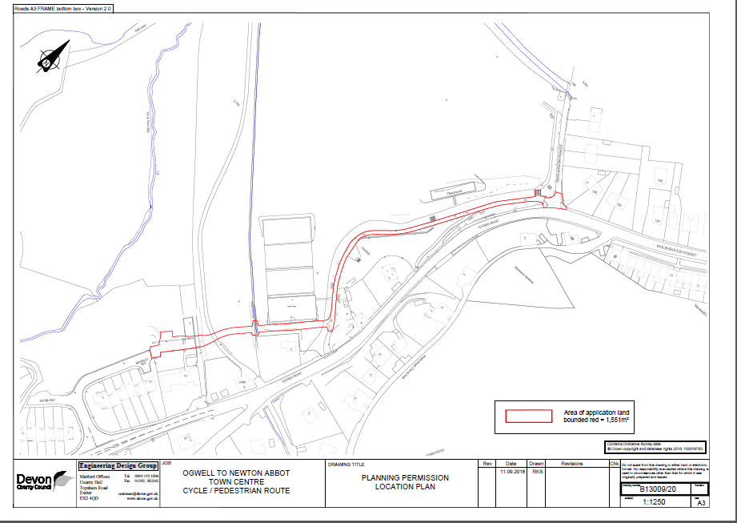
Baker’s Park / Ogwell Route

Slide 10
Cycling in Parks?
General consensus cycling in Forde Park and Courtenay Park generally not necessary and some risk of conflict
Quieter roads alongside Park to suit most cycle user types, including less confident
Possible short cut in NE corner of Courtenay Park, as part of Future High Street Fund proposal

Slide 11
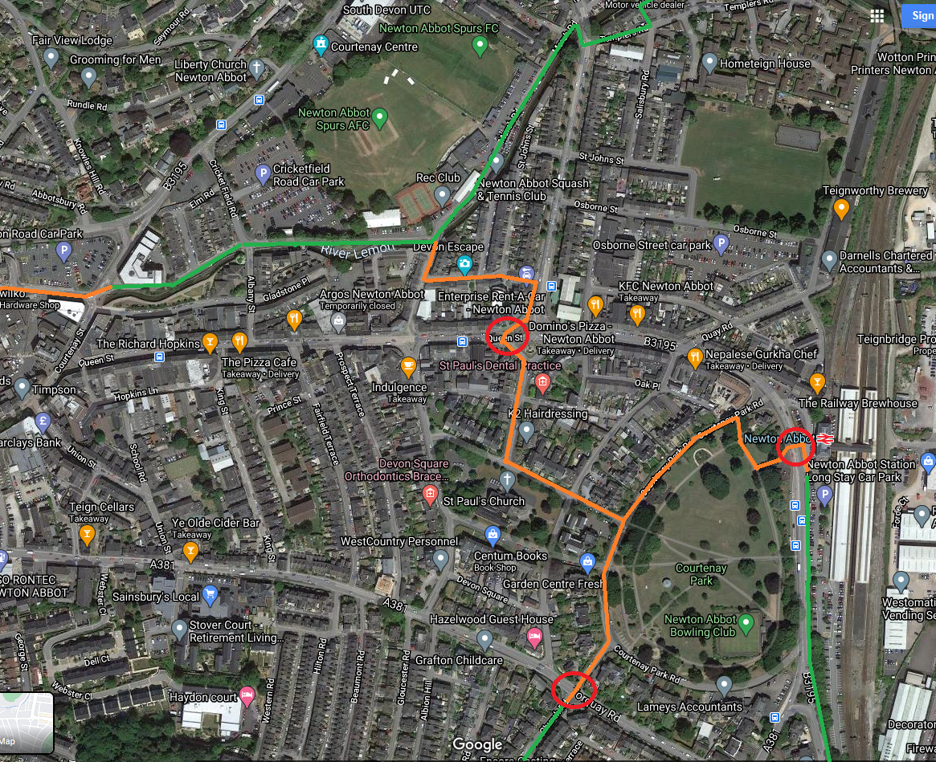
Newton Abbot Town Centre, potential links

Slide 12
South-west Exeter
£55m external funding secured for significant infrastructure works / provision to facilitate SW Exeter development
Includes new cycle + pedestrian bridge over A379 linking development on either sides – new all ages school and community building, new countryside park
Improved cycle and pedestrian link E – W through development, avoiding A379, linking to existing network Marsh Barton & Exe Estuary Trail
Old Matford Road – likely to become active travel only through route, subject to consultation

Slide 13
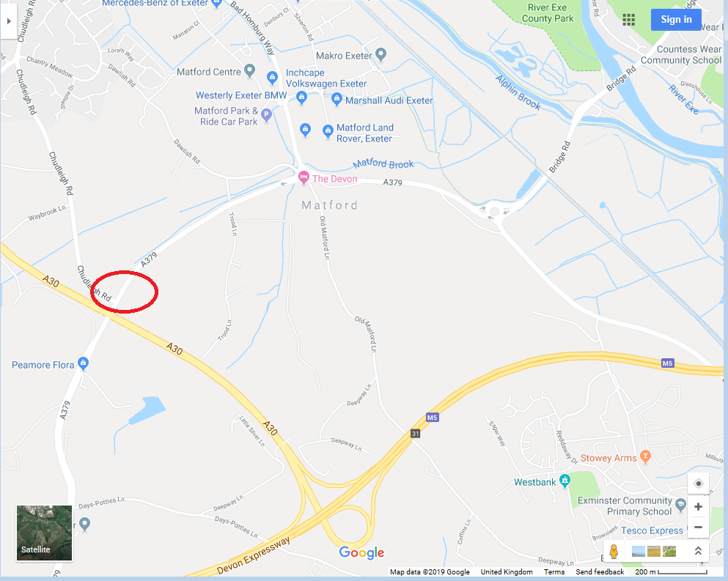
South-west Exeter – cyclist + pedestrian bridge over A379

Slide 14
Chudleigh - Local Linkages
Town Councillors & Active Travel Group very keen to work towards being linked into network, Chudleigh Knighton, Bovey, Kingsteignton
Chudleigh youngsters, Kingsteignton education catchment
Active Travel Group has been discussing route options, and promoting a riverside link to Chudleigh Knighton
We will continue to listen to local input
This is not a strategic need in the Devon Walking & Cycling Strategy but is recognised in the Teignbridge Green Infrastructure Strategy as a locally important link
Remain alert to funding opportunities both to support design and delivery

Slide 15
Newton Abbot Cycle Hub &
Torbay Velopark – complimentary proposals
Calls for establishing a cycle hub in Newton Abbot
Teignbridge District Council keen to support this
Early options review, Ride-On interest
Ideas / inputs please get in touch (email displayed on final slide)
British Cycling, Places to Ride
Mid-Devon Cycle Club & partners, proposal at Velopark
Liam McGrath, Chairman MDCC

Slide 16

Dartmoor National Park Authority
Active Travel update
Jen Manning, DNPA Recreation Officer
Very early outline review
Understanding better the locally identified needs
Particularly along the A38 corridor
Buckfastleigh – Ashburton (& Newton Abbot)
Ivybridge – Bovey Tracey
Cycling hub potential
E-hire opportunities

Slide 17
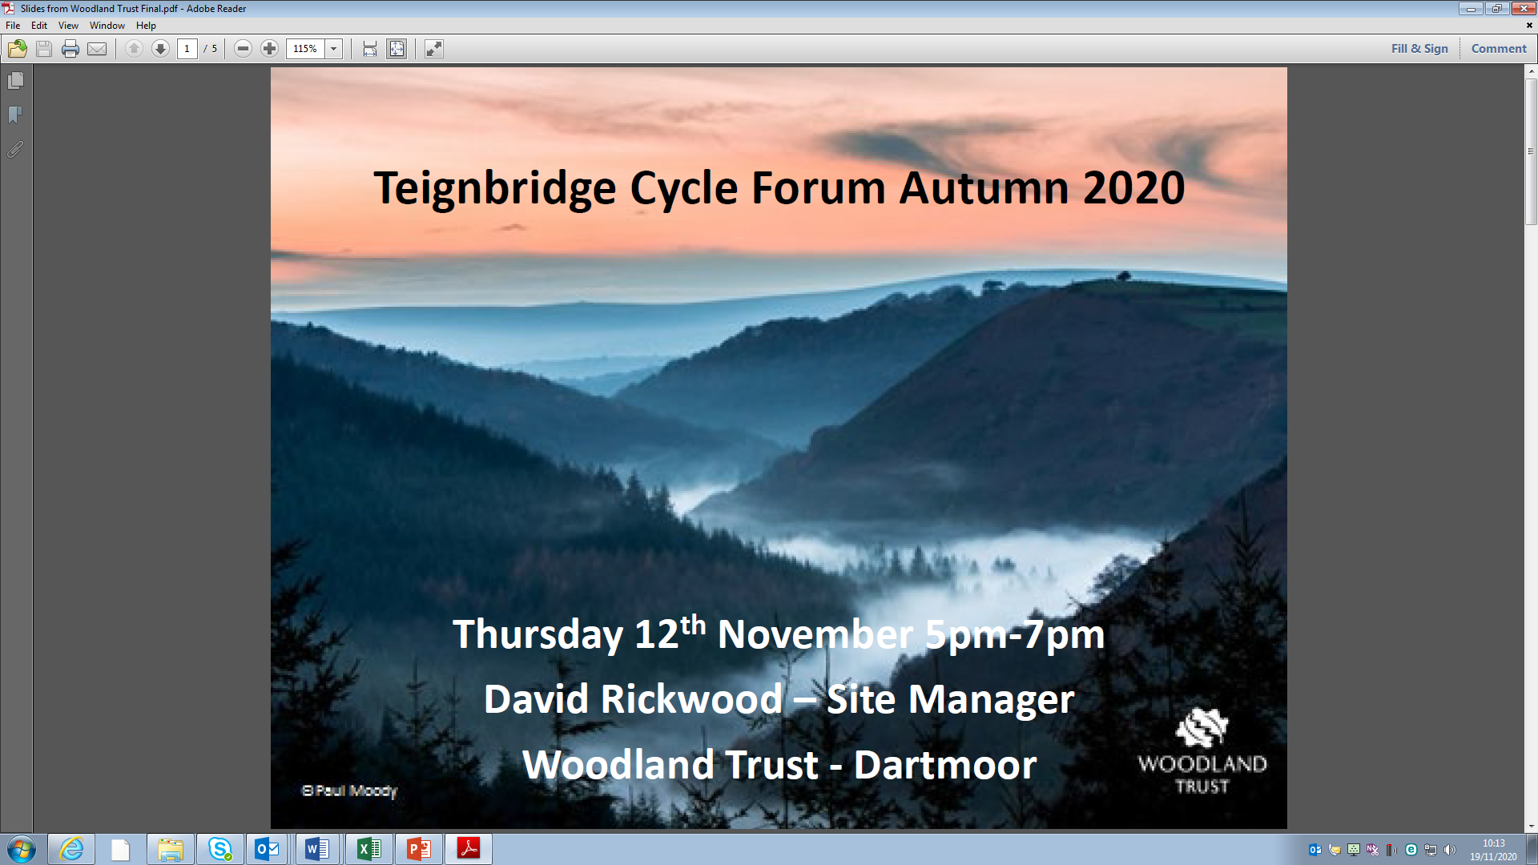
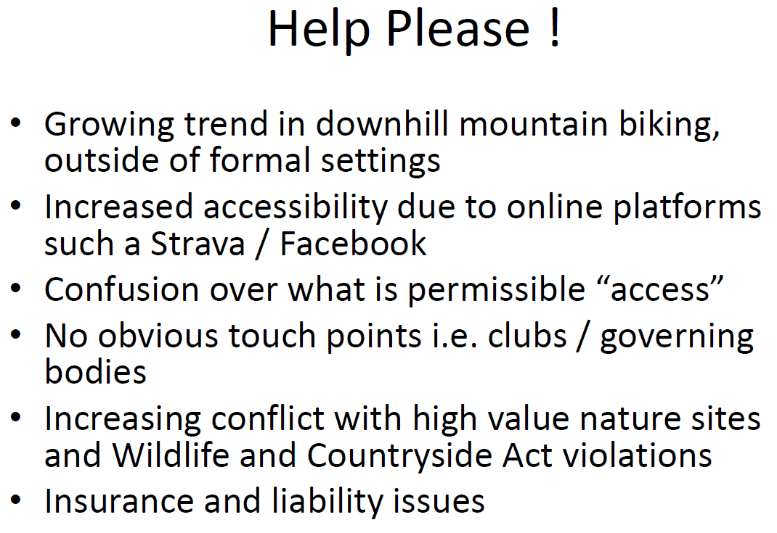
DavidRickwood@woodlandtrust.org.uk

Slide 18
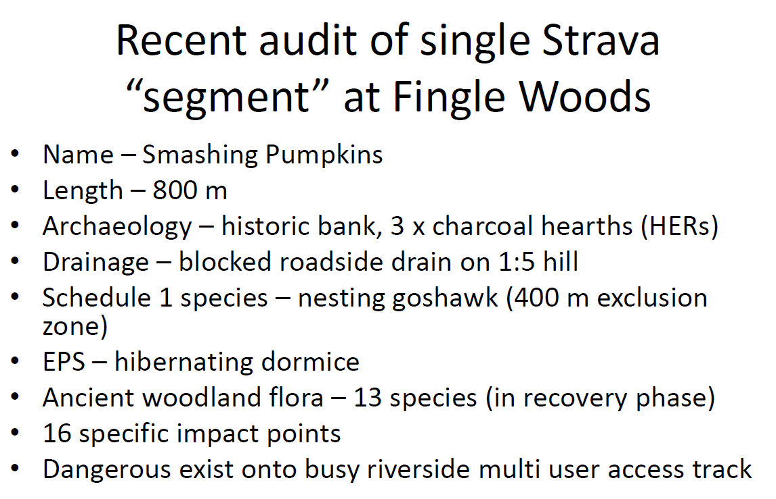

Slide 19
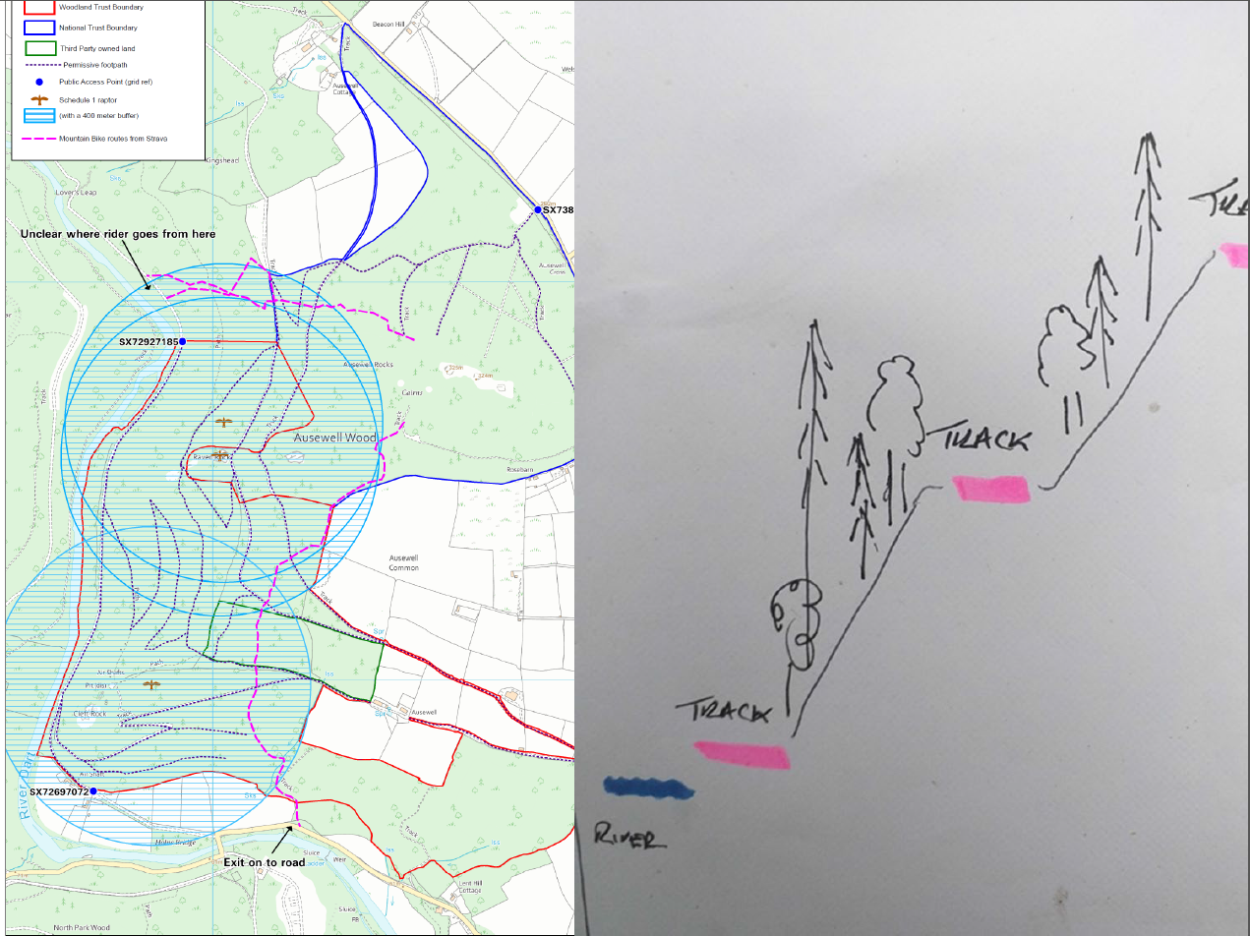

Slide 20
Any Other Business?...
Further questions or inputs on opportunities or issues – please raise your virtual Zoom blue hand
Estelle Skinner
Green Infrastructure Officer, Teignbridge District Council
estelle.skinner@teignbridge.gov.uk
Devon County Council
Cycle path maintenance / hazard issues:
https://www.devon.gov.uk/roadsandtransport/report-a-problem/

